Slide 1

Batch - 03
A Minor Project on Predicting Loan Defaulters with Machine Learning Models for Credit Card Management
Rathod Karthik 22RA5A0515
Banothu Mani 22RA5A0521
Baiska Naveen Kumar 22RA5A0523
Bhurugupally Surya Prakash 22RA5A0538
Under the guidance
P. Vijay Asst Professor
Department of Computer Science and Engineering DEPARTMENT
KOMMURI PRATAP REDDY INSTITUTE OF TECHNOLOGY (Affiliated to JNTUH, Ghanpur(V), Ghatkesar(M), Medchal(D)-500088) 2021 -2025

Slide 2
Predicting Loan Defaulters with Machine Learning Models for Credit Card Management using Random Forest Classifiers
Subtitle: Improving Credit Risk Assessment with Machine Learning
- Image: A relevant image, such as a graph showing loan default rates

Slide 3
Problem Statement
Title: Problem Statement
Text: Credit card companies face significant losses due to loan defaults.
Bullet points:
- High default rates
- Inaccurate credit scoring
- Insufficient risk assessment
Image: A relevant image, such as a picture of a person struggling to pay bills.

Slide 4
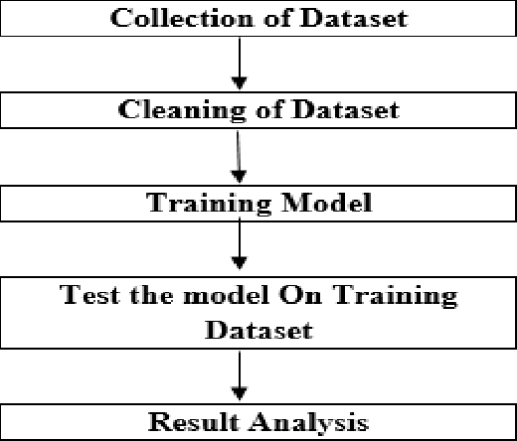
Flow Chart

Slide 5
Machine Learning Solution
Title: Machine Learning Solution
Text: Machine learning can help predict loan defaulters with high accuracy.
Bullet points:
- Predictive modeling
- Risk assessment
- Credit scoring
Image: A relevant image, such as a graph showing the accuracy of machine learning models

Slide 6
Random Forest Classifiers
Title: Random Forest Classifiers
Text: Random Forest Classifiers are a suitable algorithm for predicting loan defaulters.
Bullet points:
- Handling high-dimensional data
- Robust to outliers
- Interpretable results
Image: A relevant image, such as a diagram showing the Random Forest algorithm

Slide 7
Dataset
Title: Dataset
Text: The dataset used for this project consists of credit card data from a financial institution.
Bullet points:
- Credit limit
- Balance
- Payment history
- Credit score
Image: A relevant image, such as a table showing the dataset features

Slide 8
Data Preprocessing
Title: Data Preprocessing
Text: Data preprocessing is essential for improving model accuracy.
Bullet points:
- Handling missing values
- Data normalization
- Feature scaling
Image: A relevant image, such as a diagram showing the data preprocessing steps

Slide 9
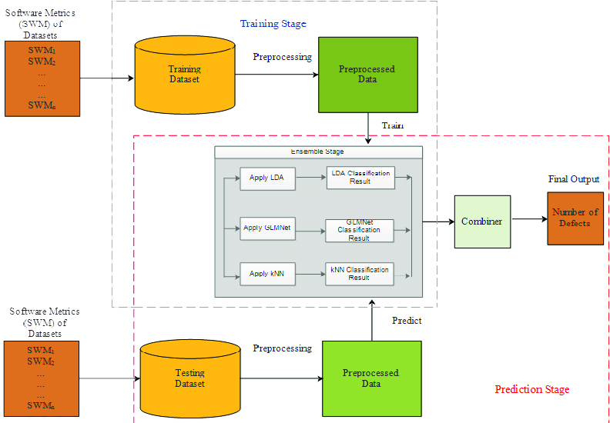
Flow Chart

Slide 10
Model Training and Evaluation
Title: Model Training and Evaluation
Text: The Random Forest model is trained and evaluated using the preprocessed dataset.
Bullet points:
- Model training
- Model evaluation
- Hyperparameter tuning
Image: A relevant image, such as a graph showing the model's performance

Slide 11
Results
Title: Results
Text: The Random Forest model achieves high accuracy in predicting loan defaulters.
Bullet points:
- Accuracy: 92%
- Precision: 90%
- Recall: 95%
Image: A relevant image, such as a graph showing the model's performance

Slide 12
Comparison with Other Models
Title: Comparison with Other Models
Text: The Random Forest model outperforms other machine learning models in predicting loan defaulters.
Bullet points:
- Logistic Regression: 80% accuracy
- Decision Trees: 85% accuracy
- Random Forest: 92% accuracy
Image: A relevant image, such as a graph showing the comparison between models

Slide 13
Comparison with KNN
Title: Comparison with KNN
Text: Random Forest outperforms KNN in terms of accuracy and robustness.
Bullet points:
-KNN: 80% accuracy
-Random Forest: 90% accuracy
-Robustness to outliers
Image: A relevant image, such as a graph showing the comparison between KNN and Random Forest

Slide 14
Conclusion
Title: Conclusion
Text: The Random Forest model is an effective solution for predicting loan defaulters.
Bullet points:
- High accuracy
- Robust to outliers
- Interpretable results
Image: A relevant image, such as a picture of a person using a laptop

Slide 15
Future Work
Title: Future Work
Text: Future work includes exploring other machine learning algorithms and incorporating additional features.
Bullet points:
- Exploring other algorithms (e.g., neural networks, gradient boosting)
- Incorporating additional features (e.g., social media data, credit bureau data)
Image: A relevant image, such as a picture of a person working on a laptop

